Slide 1
Minor Project
On
ATM_Machine
Submitted to:
Pooja Mehta
Submitted by:
Mohammed Zeba

Slide 2
ATM_Machine​
CONTENTS :
1. Introduction to Project
2. What is Class
3. What is Scanner Class
4. Control Statements
5. Switch Statement
6. Output

Slide 3
ATM_Machine​​
Introduction to Project :
1. In Java, we can create an ATM program for representing ATM transection. In the ATM program, the user has to select an option from the options displayed on the screen. The options are related to withdraw the money, deposit the money, check the balance, and exit.
2. To withdraw the money, we simply get the withdrawal amount from the user and remove that amount from the total balance and print the successful message.
3.To deposit the money, we simply get the deposit amount from the user, add it to the total balance and print the successful message.
4. To check balance, we simply print the total balance of the user.
5. We use the exit(0) method to exit from the current Transaction mode and return the user to the home page or initial screen.

Slide 4
ATM_Machine​​
What is Class :
A class is a basic building block. It can be defined as template that describes the data and behavior associated with the class instantiation. Instantiating is a class is to create an object (variable) of that class that can be used to access the member variables and methods of the class.
A class can also be called a logical template to create the objects that share common properties and methods.

Slide 5
ATM_Machine​​
What is Scanner Class :
The Scanner class is used to get user input, and it is found in the java.util package.
To use the Scanner class, create an object of the class and use any of the available methods found in the Scanner class documentation.
The nextLine() method, is used to read Strings.

Slide 6
ATM_Machine​​
Control Statements :
While Loop :
while loop is used to iterate a part of the program repeatedly until the specified Boolean condition is true. As soon as the Boolean condition becomes false, the loop automatically stops. The while loop is considered as a repeating if statement. If the number of iteration is not fixed, it is recommended to use the while loop.
If-else Statement :
The Java if-else statement also tests the condition. It executes the if block if condition is true otherwise else block is executed.

Slide 7
ATM_Machine​​
Switch Statement :
The switch statement is a multi-way branch statement. In simple words, the Java switch statement executes one statement from multiple conditions. It is like an if-else-if ladder statement. It provides an easy way to dispatch execution to different parts of code based on the value of the expression. Basically, the expression can be a byte, short, char, and int primitive data types. It basically tests the equality of variables against multiple values.

Slide 8
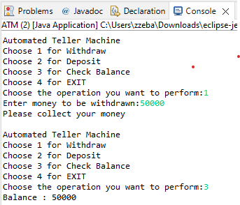
ATM_Machine​​
Output :

